Slide 1
Module-2 Decision Tree Learning

Slide 2
Decision Trees
Decision tree learning is a method for approximating discrete value target functions, in which the learned function is represented by a decision tree.
Decision trees can also be represented by if-then-else rule.
Decision tree learning is one of the most widely used approach for inductive inference .

Slide 3
Introduction
Decision Tree is a method that uses inductive inference to approximate a target function, which will produce discrete values (Discrete data can only take particular values. ... Discrete data can be numeric -- like numbers of apples -- but it can also be categorical -- like red or blue, or male or female, or good or bad.).
Inductive inference is the process of reaching a general conclusion from specific examples.
Inductive Learning Hypothesis: any hypothesis found to approximate the target function well over a sufficiently large set of training examples will also approximate the target function well over other unobserved examples.
It is widely used, robust to noisy data, and considered a practical method for learning disjunctive expressions.

Slide 4
A Decision Tree is a tree where
Each node represents a Feature (Attribute),
Each link (branch) represents a decision (rule) and
Each leaf representsan outcome.

Slide 5
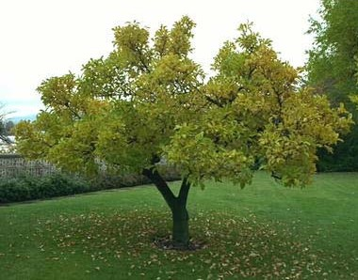
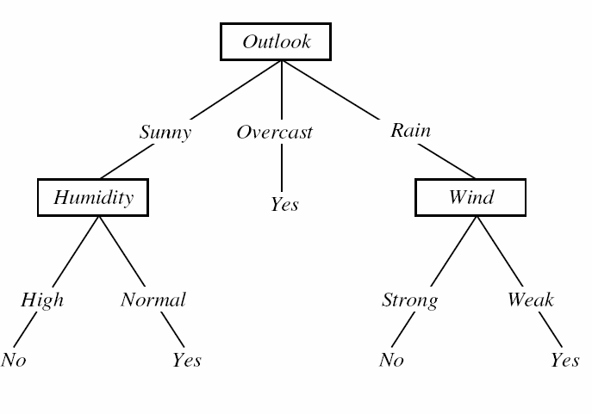
Decision Trees
An instance is classified by starting at the root node of the tree, testing the attribute specified by this node, then moving down the tree branch corresponding to the value of the attribute in the given example. This process is then repeated for the subtree rooted at the new node.

Slide 6

Decision Trees

Slide 7
Decision Trees (F = A ^ B')
F = A ^ B‘
If (A=True and B = False) then Yes else
No
If then else form
A
False
True
No
B
False
True
Yes
No

Slide 8
Decision Trees (F = A V (B ^ C))
If (A=True) then Yes
else if (B = True and C=True) then Yes else No
If then else form
A
True
False
Yes
B
False
True
No
C
False
True
No
Yes

Slide 9
Decision Trees (F = A XOR B)
F = (A ^ B') V (A' ^ B)
If (A=True and B = False) then Yes
else If (A=False and B = True) then Yes else No
If then else form
A
False
True
B
B
False
False
True
True
No
Yes
No
Yes

Slide 10
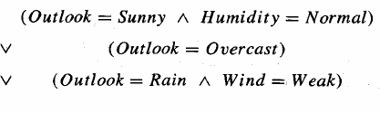
Decision Trees as If-then-else rule
conjunction
disjunction
If (Outlook = Sunny AND humidity = Normal) then PlayTennis = Yes
If (Outlook = Overcast) then PlayTennis = Yes
If (Outlook = Rain AND Wind = Weak) then PlayTennis = Yes

Slide 11
Appropriate Problems for Decision Tree Learning
Decision tree learning is generally best suited to problems with the following characteristics:
Instances are represented by attribute-value pairs (temperature = Hot)
The target function has discrete output values. (yes or no)
Disjunctive descriptions may be required.
The training data may contain errors.
The training data may contain missing attribute values.
After a decision tree learns classification rules, it can also be re-represented as a set of if-then rules in order to improve readability.

Slide 12
Decision Tree Representation
Decision trees classify the instances by sorting them down the tree from the root node to some leaf node, which provides the classification of the instance.
Each node in the tree specifies a test of some attribute of the instance and each branch descending from that node corresponds to one of the possible values for this attribute.
An instance is classified by starting at the root node of the tree, testing the attribute specified by this node, then moving down the tree branch corresponding to the value of the attribute in the given example.
This process is then repeated for the subtree rooted at the new node.
Next- Decision tree for concept PLAYTENNIS

Slide 13


Algorithms
Cart
Gini Index
ID3
Entropy Function Information Gain

Slide 14
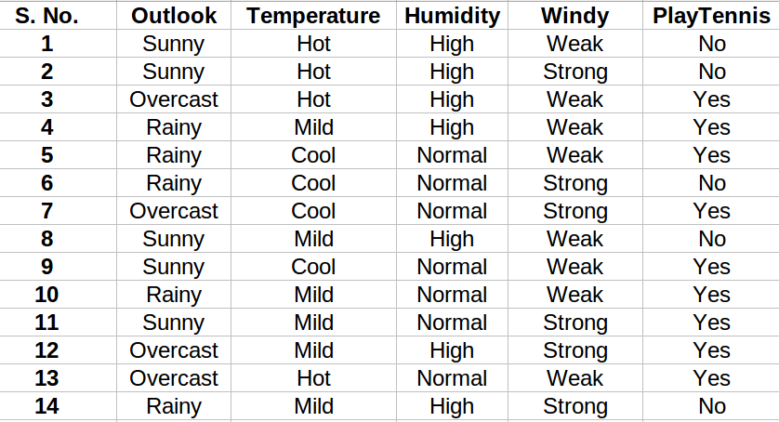
Make a decision tree that predicts whether tennis will be played on the day?

Slide 16

Step 1: Create a root node
How to choose the root node?
The attribute that best classifies the training data, use this attribute at the root of the tree.

Slide 17
Step 1: Create a root node
How to choose the root node?
The attribute that best classifies the training data, use this attribute at the root of the tree.
How to choose the best attribute?
So from here, ID3 algorithm begins

Slide 18


Calculate Entropy (Amount of uncertainity in dataset):
Calculate Average Information:
Calculate Information Gain: (Difference in Entropy before and after splitting dataset on attribute A)

Slide 19
compute the entropy for data-set Entropy(s)
for every attribute/feature:
calculate entropy for all other values Entropy(a)
take average information entropy for the current attribute 3.calculate gain for the current attribute
pick the highest gain attribute.
Repeat until we get the tree we desired.

Slide 20
1.
P = 9
N = 5
Total = 14

Slide 21

Calculate Entropy(S):
= 0.940

Slide 22

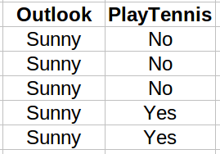
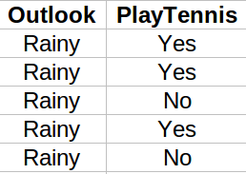
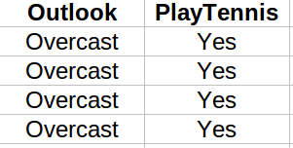

For each Attribute: (let say Outlook)
Calculate Entropy for each Values, i.e for 'Sunny', 'Rainy','Overcast'

Slide 23
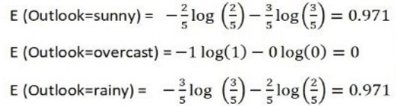
Calculate Entropy(Outlook='Value'):

Slide 24

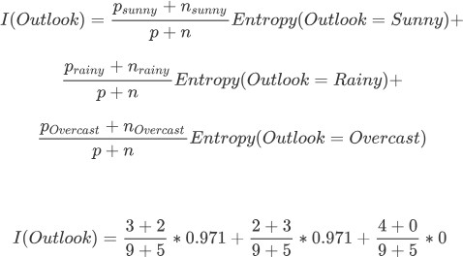
Calculate Average Information Entropy:
= 0.693

Slide 25

Calculate Gain: attribute is Outlook

Slide 26
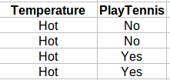
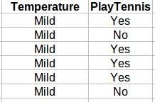
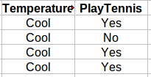

For each Attribute: (let say Temperature)
Calculate Entropy for each Temp, i.e for 'Hot', 'Mild' and 'Cool'

Slide 27
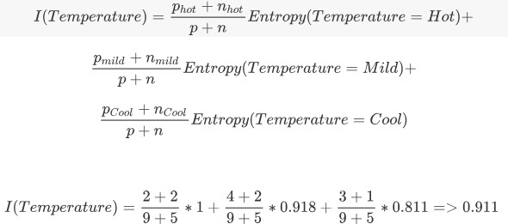
Calculate Average Information Entropy:

Slide 28

Calculate Gain: attribute is Temperature

Slide 29
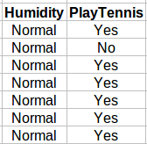
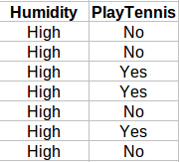

For each Attribute: (let say Humidity)
Calculate Entropy for each Humidity, i.e for 'High', 'Normal'

Slide 30
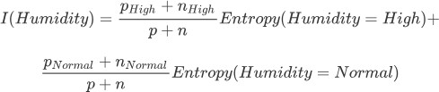
Calculate Average Information Entropy:

Slide 31

Calculate Gain: attribute is Humidity

Slide 32
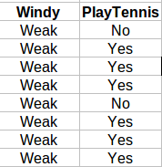
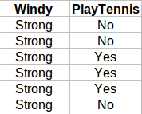

For each Attribute: (let say Windy)
Calculate Entropy for each Windy, i.e for 'Strong' and 'Weak'

Slide 33
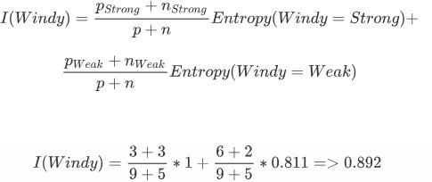
Calculate Average Information Entropy:

Slide 34

Calculate Gain: attribute is Windy

Slide 35
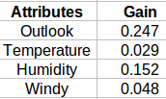
Pick the highest gain attribute.
Root Node:
OUTLOOK

Slide 36
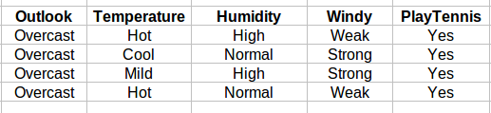
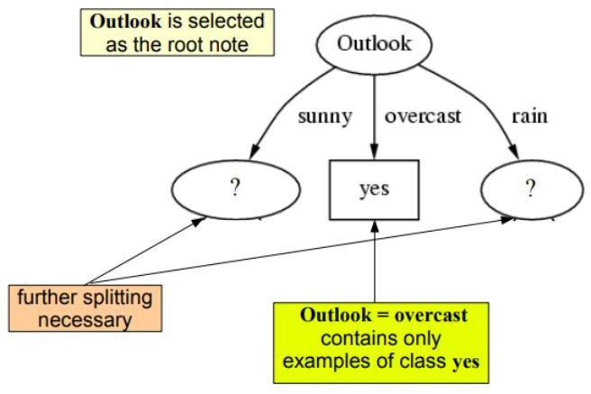

Slide 37

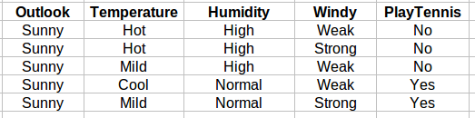
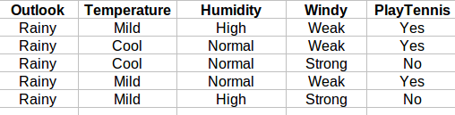
Repeat the same thing for sub-trees till we get the tree.
Outlook = "Sunny"
Outlook = "Rainy"

Slide 38

P= 2
N= 3
Total=
5
Entropy:

Slide 39
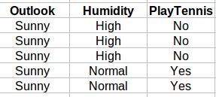

For each Attribute: (let say Humidity):
Calculate Entropy for each Humidity, i.e for 'High' and 'Normal'
Calculate Average Information Entropy:
I(Humidity) = 0
Calculate Gain:
Gain = 0.971

Slide 40
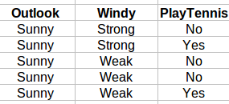

For each Attribute: (let say Windy):
Calculate Entropy for each Windy, i.e for 'Strong' and 'Weak'
Calculate Average Information Entropy:
I(Windy) = 0.951
Gain = 0.020
Calculate Gain:

Slide 41
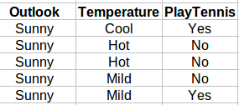

For each Attribute: (let say Temperature):
Calculate Entropy for each Windy, i.e for 'Cool', 'Hot' and 'Mild'
Calculate Average Information Entropy:
I(Temp) = 0.4
Gain = 0.571
Calculate Gain:

Slide 42

Pick the highest gain attribute.
Next Node in sunny:
Humidity

Slide 43
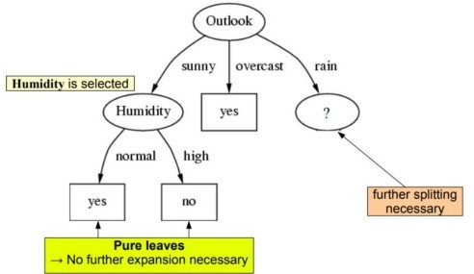

Slide 44

P=
N=
3
2
Total = 5
Entropy:

Slide 45
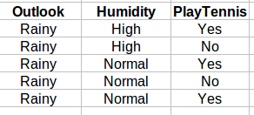

For each Attribute: (let say Humidity):
Calculate Entropy for each Humidity, i.e for 'High' and 'Normal'
Calculate Average Information Entropy:
I(Humidity) = 0.951
Calculate Gain:
Gain = 0.020

Slide 46
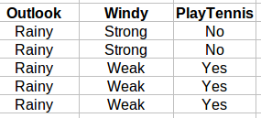

For each Attribute: (let say Windy):
Calculate Entropy for each Windy, i.e for 'Strong' and 'Weak'
Calculate Average Information Entropy:
I(Windy) = 0
Gain = 0.971
Calculate Gain:

Slide 47
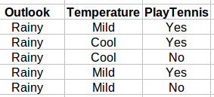

For each Attribute: (let say Temperature):
Calculate Entropy for each Windy, i.e for 'Cool', 'Hot' and 'Mild'
Calculate Average Information Entropy:
I(Temp) = 0.951
Gain = 0.020
Calculate Gain:

Slide 48

Pick the highest gain attribute.
Next Node in Rainy:
Windy

Slide 49
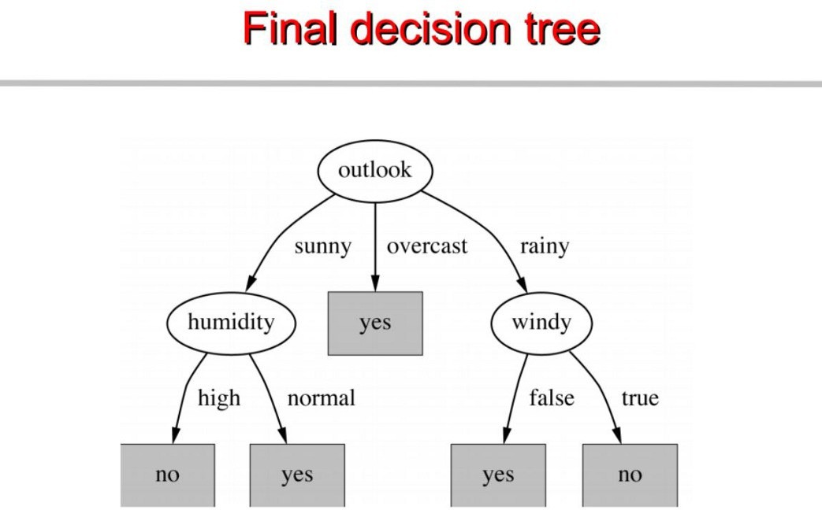
Weak
Strong

